Slide 1
Tips and tricks for organizing your academic workflow
Espen Stranger-Johannessen
November 13, 2013
UBC

Slide 2
Part I: Tips and tricks

Slide 3
Shortcuts
General shortcuts
⌘ + tab Change program
⌘ + ` Change window
⌘ + space Spotlight search
⌘ + , Settings
⌘ + shift 3 Screenshot (full)
⌘ + shift 4 Screenshot (select)

Slide 4
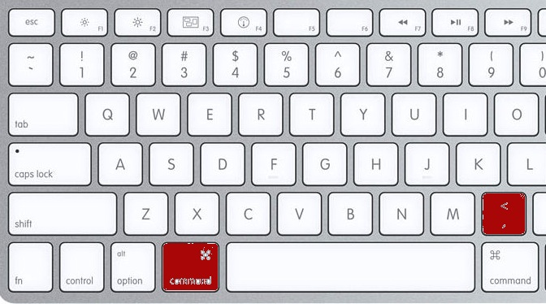
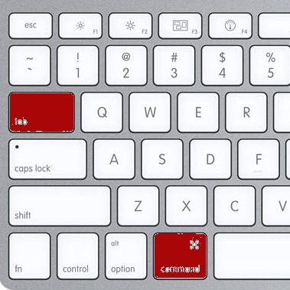
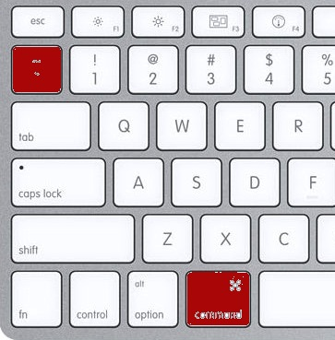
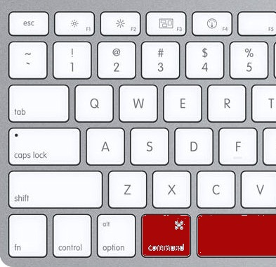
Settings Next
program
Next Spotlight
window search

Slide 5
Programs (1)
Finder
<space> to preview file
Type to locate a file
Side menu: add folders
Copy list of files to text editor

Slide 6
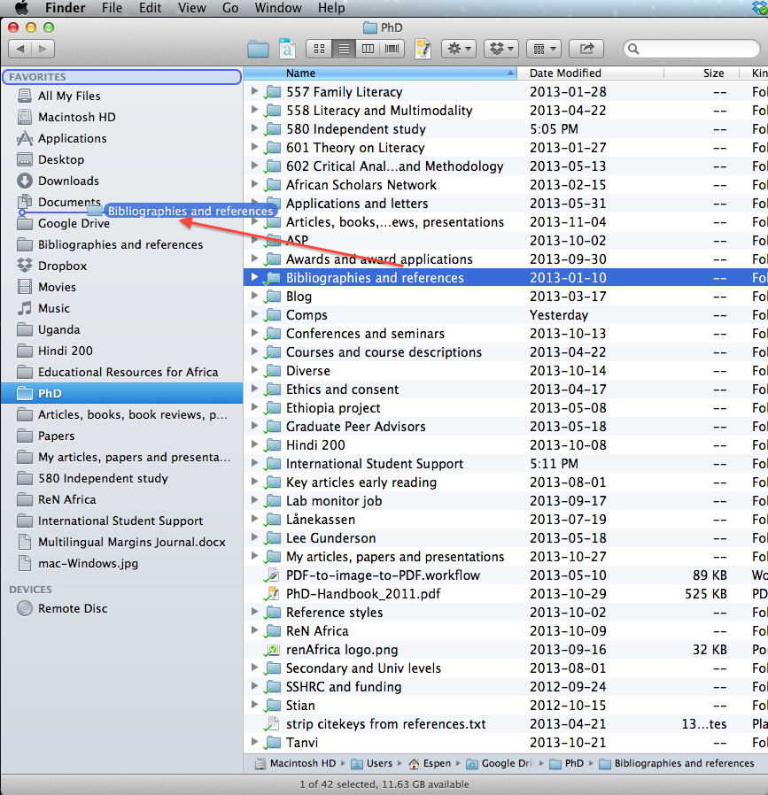

Slide 7
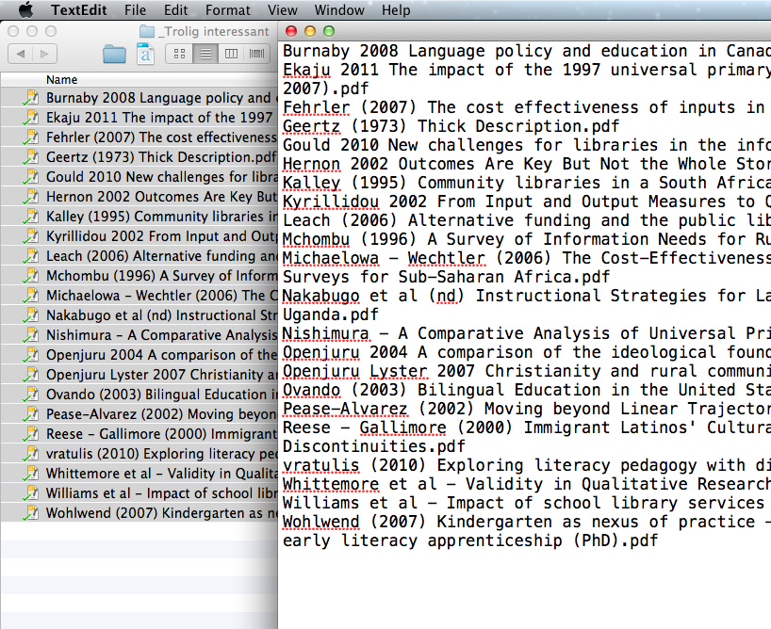
List of files TextEdit (.txt document)
copy ➔ paste

Slide 8
Programs (2)
Automator
Executes series of operations
merge pdfs
pdf to/from images
extract text
and more...
Macintosh HD/Applications/Automator.app

Slide 9
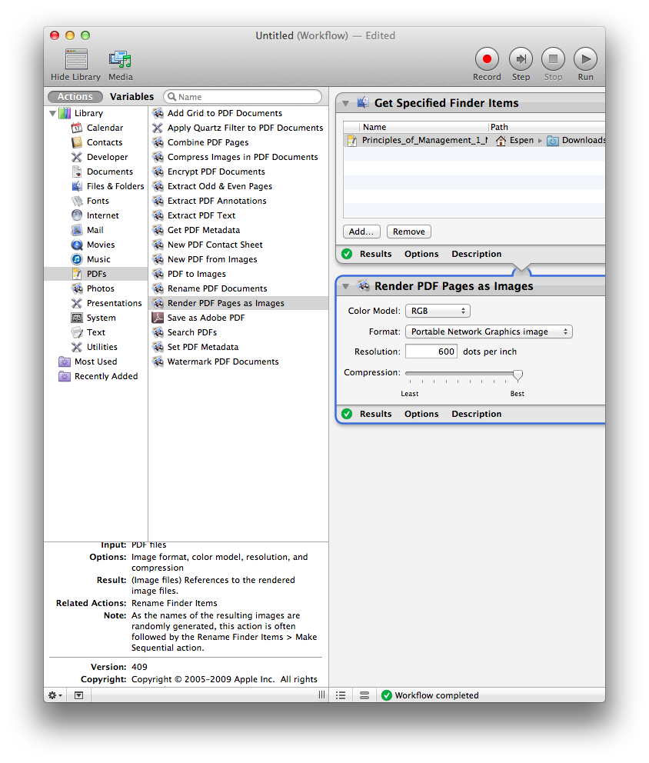

Slide 10
Programs (3)
Dictionary
Dictionary and thesaurus
Dictionary (command + 1)
Thesaurus (command + 2)
Macintosh HD/Applications/Dictionary.app

Slide 11
Programs (4)
Audacity
Audio recording and editing
Remove noise
Amplify sound
http://audacity.sourceforge.net/

Slide 12
Programs (5)
Evernote
Taking notes
Many options
Online back-up
http://evernote.com/

Slide 13
Programs (6)
Notational Velocity
Taking notes
Online back-up options
Simple
http://notational.net/

Slide 14
Evernote Notational Velocity

Slide 15
Programs (7)
Picasa
Picture organizer and editor
Batch edit
Crop
resize
http://picasa.google.com/

Slide 16
Programs (8)
Skim
PDF reader and annotating tool
Highlight
Annotate
Export highlights and notes
http://skim-app.sourceforge.net/
Windows alternative:
http://pdf-xchange-viewer.en.softonic.com/

Slide 17
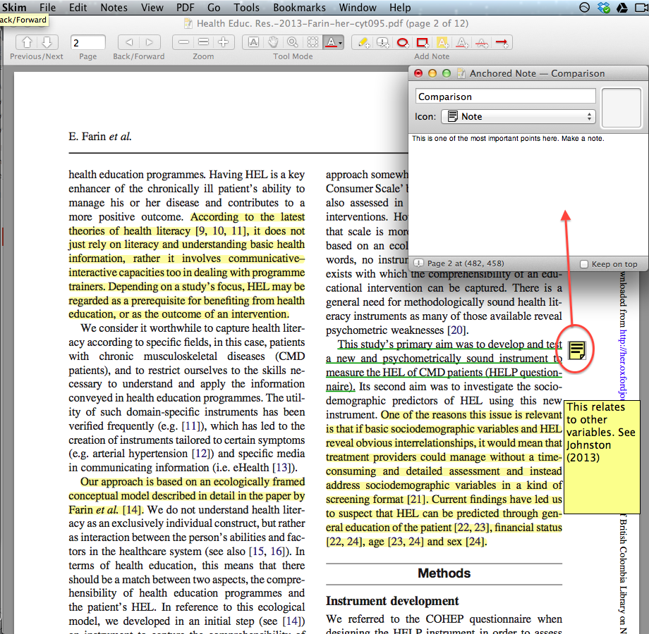

Slide 18
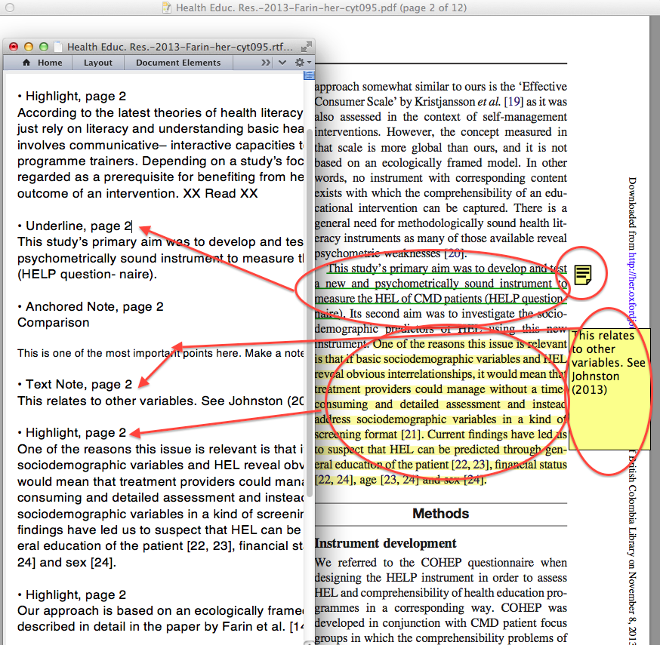

Slide 19
Programs (9)
Preview
pdf and image viewer
image → pdf
delete pdf pages
add pdf pages
re-mix pdf pages

Slide 20
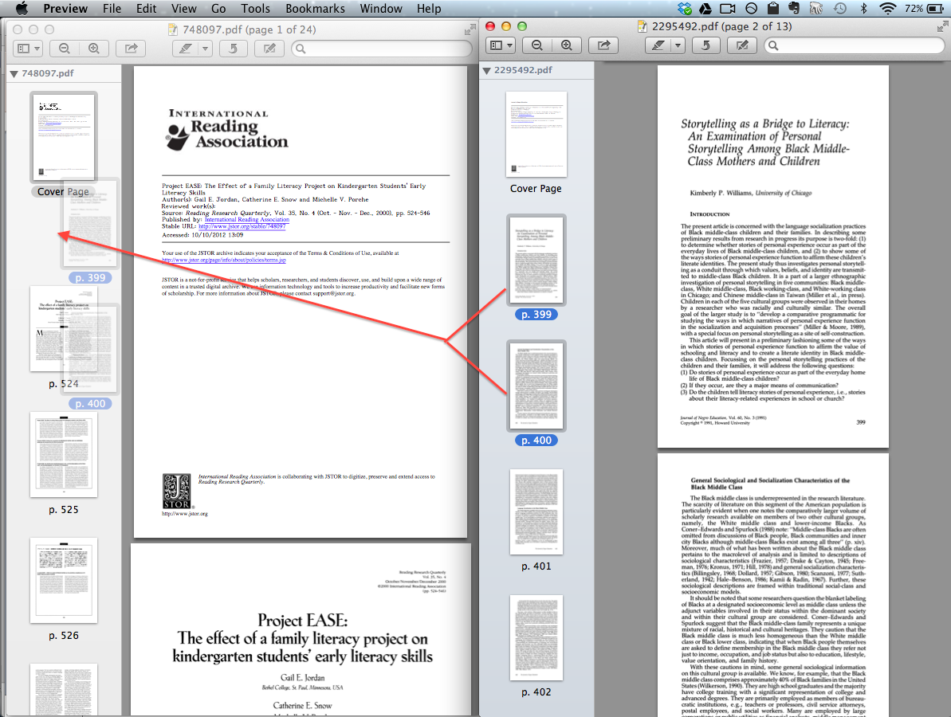

Slide 21
Programs (10)
f.lux
Background light modifier
Warmer (reddish) light at night
Less straining on the eyes
http://justgetflux.com/

Slide 22
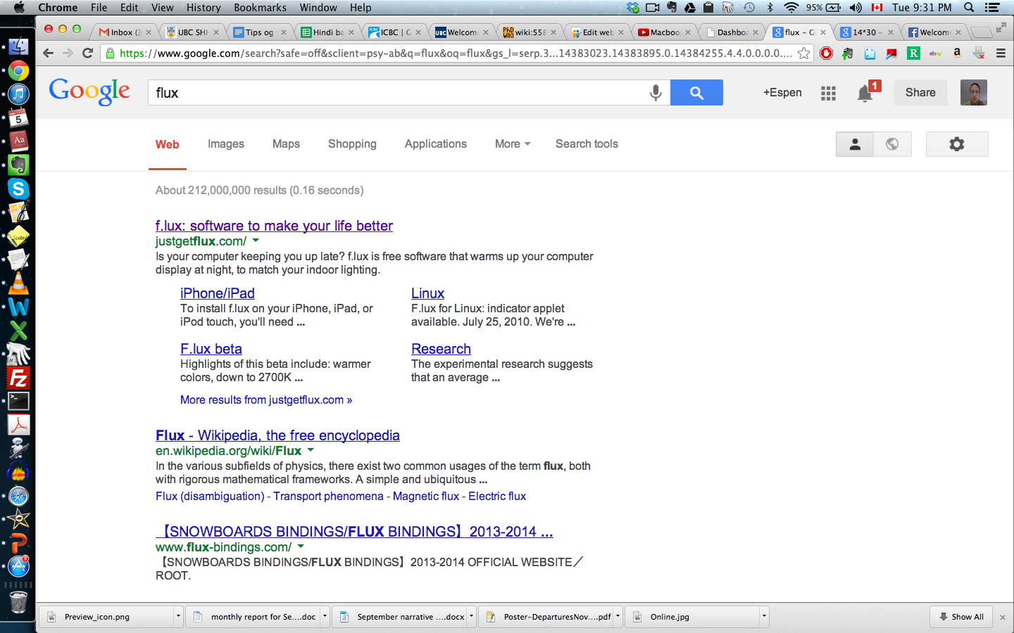
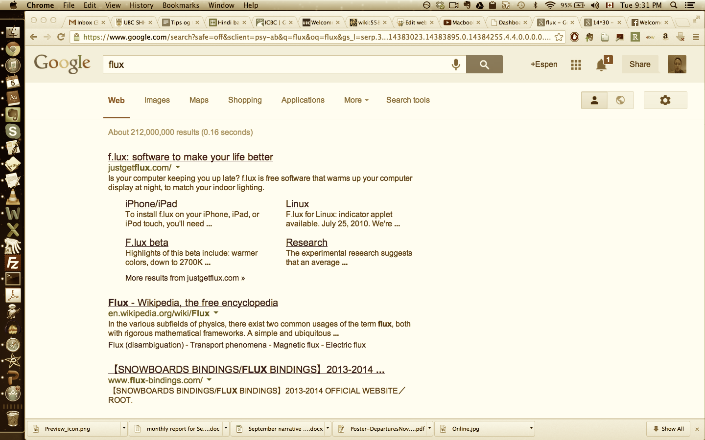
Normal f.lux (approximate)

Slide 23
Programs (11)
VLC
Media player
Can increase playback speed
http://www.videolan.org/

Slide 24
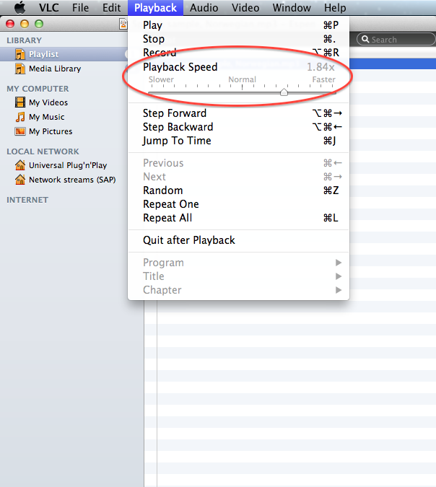

Slide 25
Programs (12)
Zotero (or other)
Reference manager
Indispensible for PhD students
Necessary for MA students
Useful for MEd students
http://www.zotero.org/

Slide 26
Program shortcuts (1)
Google Chrome
Shortcuts:
⌘ 1…8 : Go to tab # 1…8
⌘ 9 : Go to last tab
⌘ + / – : Increase/ decrease font
⌘ L : Go to URL field
⌘ T : New tab
⌘  T : Restore deleted tab
https://google.com/intl/en/chrome/browser/

Slide 27
Program shortcuts (2)
Microsoft Word (Office suite)
Shortcuts:
⌘⌥ R : Show/hide ribbon
⌘⌥ T : Show/hide icons
⌘⌥ M : Paragraph
⌘ D : Font
⌘⌥V : Paste and match formatting

Slide 28
Default ⌘⌥ R ⌘⌥ T

Slide 29
MS Word Program features (1)
Advanced find and replace
^$ : any character
^# : any digit
^p : paragraph mark (¶)
etc.

Slide 30
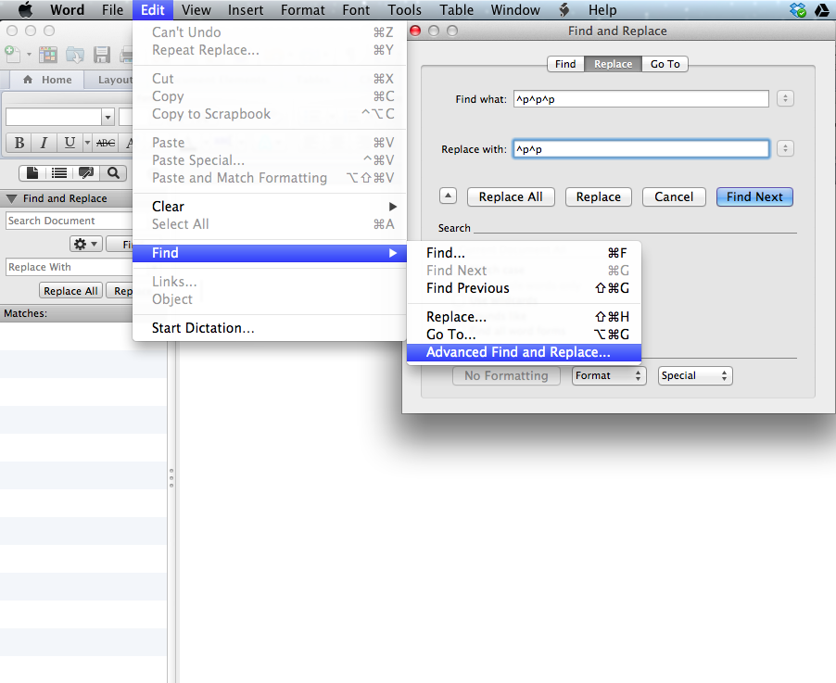

Slide 31
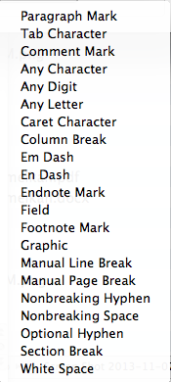
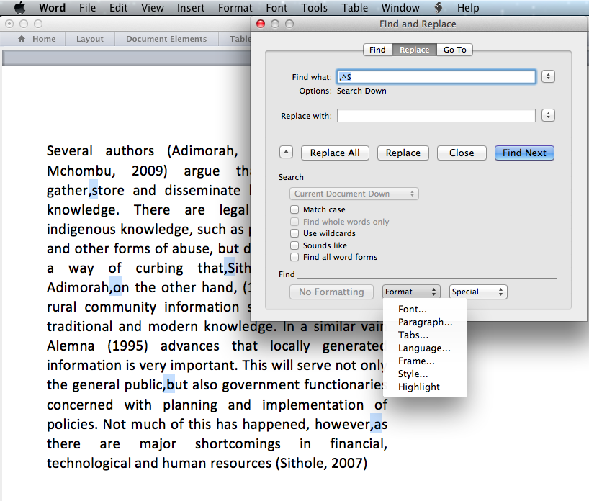

Slide 32
MS Word program features (2)
Tips to search for
<space> <space> [never use it]
<space> <full stop>
One paragraph break too many (^p^p^p) (replace with (^p^p)
Any year (^#^#^#^#)

Slide 33
Online services (1)
Google Scholar
Academic search engine
World’s biggest
UBC link
Cited by
Import metadata into reference manager
Subscribe to searches
Set up scholarly profile
http://scholar.google.ca/

Slide 34
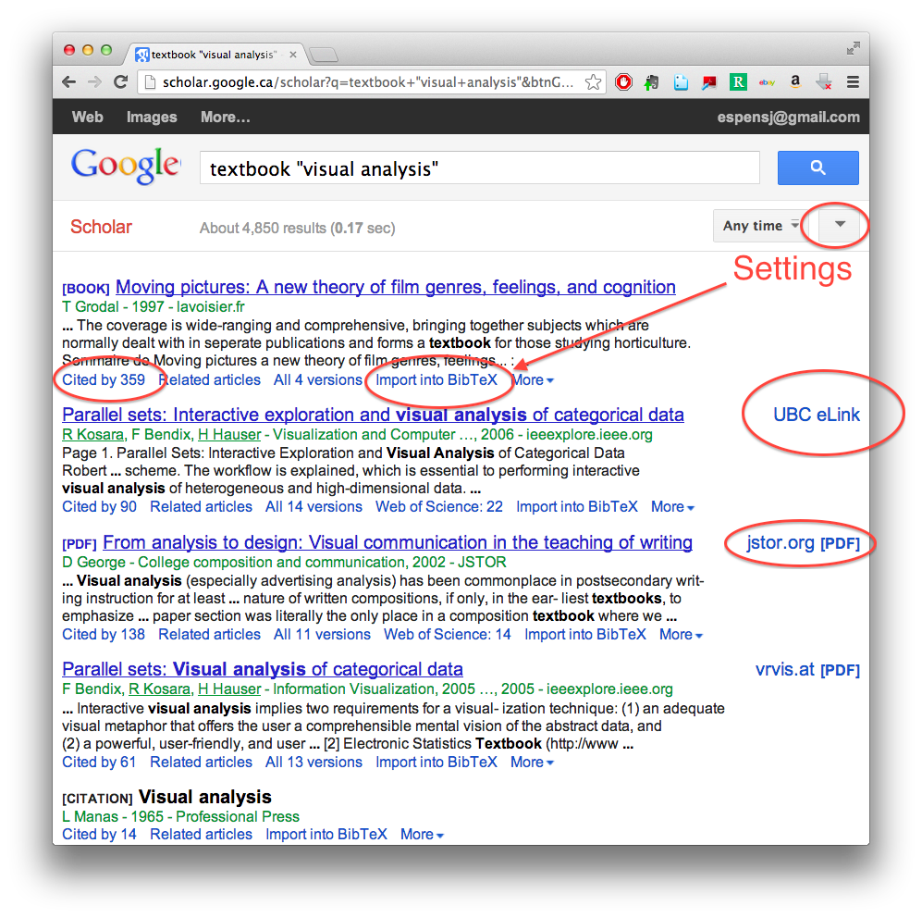

Slide 35
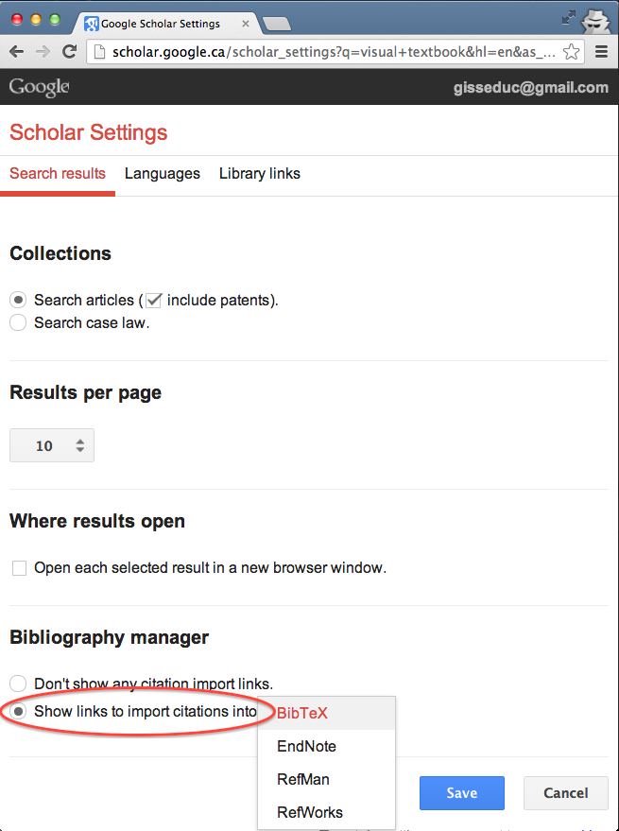
Note:
References need to be “cleaned up” – do at once

Slide 36
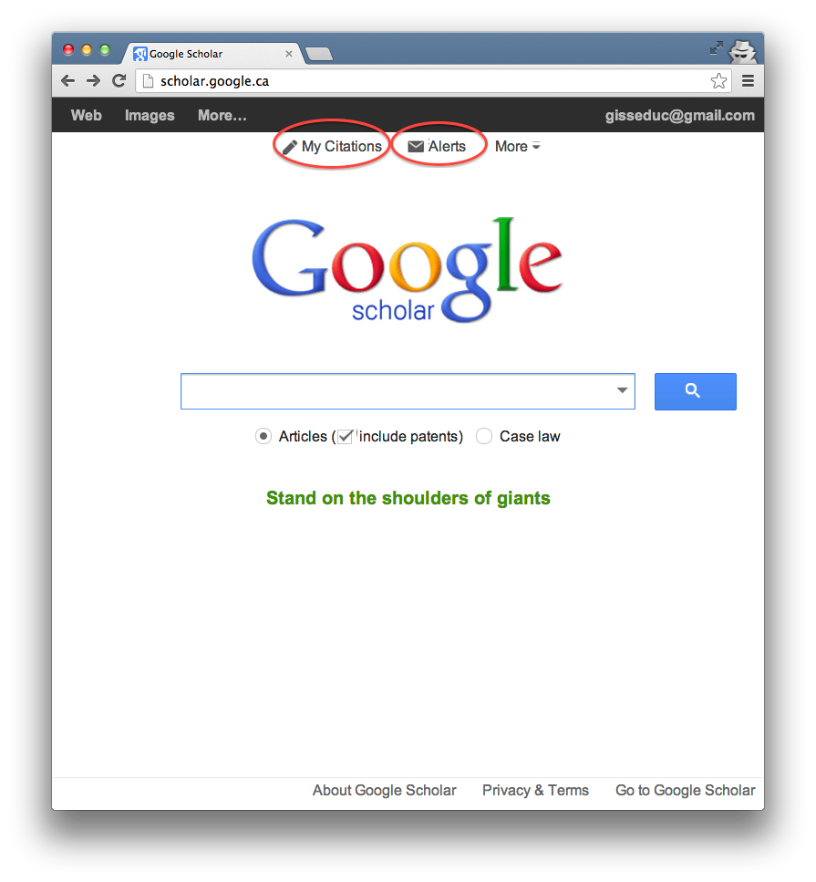

Slide 37
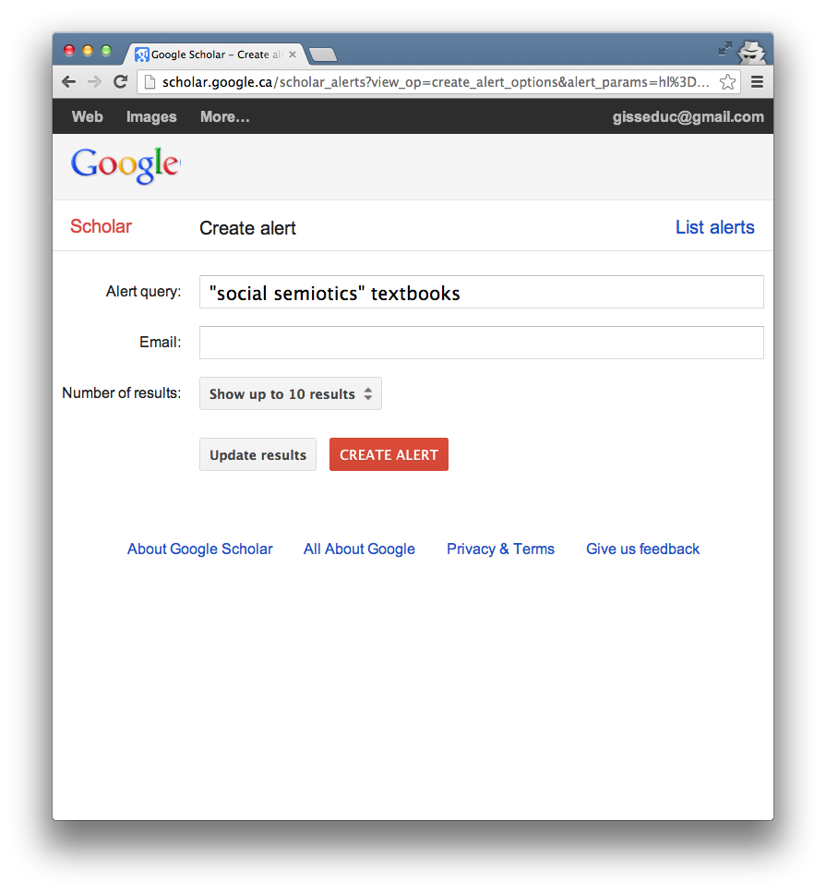

Slide 38
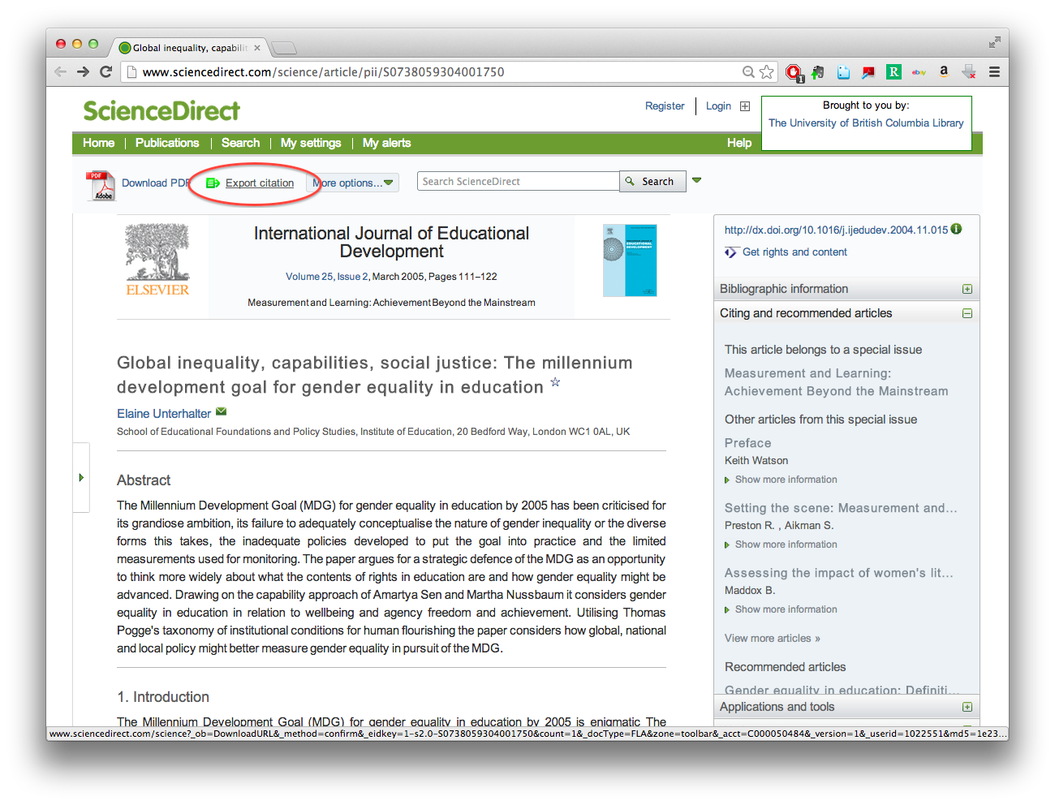
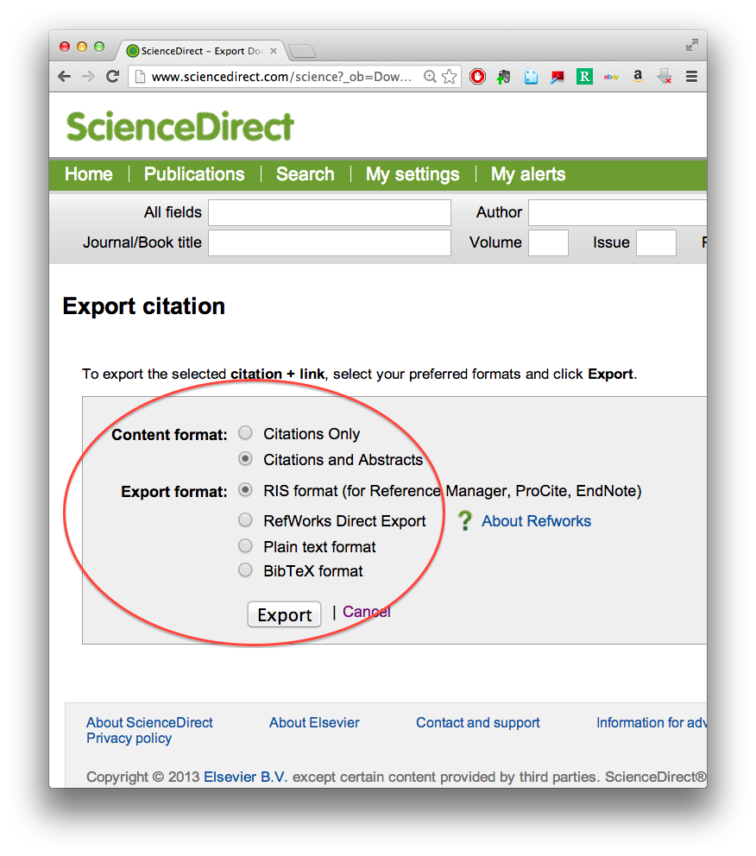
Online services (2)
Download citation from journal

Slide 39
Online services (3)
Google
Check grammar
Collocation (e.g., prepositions)
Calculator
Unit and currency convertor
Dictionary
http://google.ca/

Slide 40
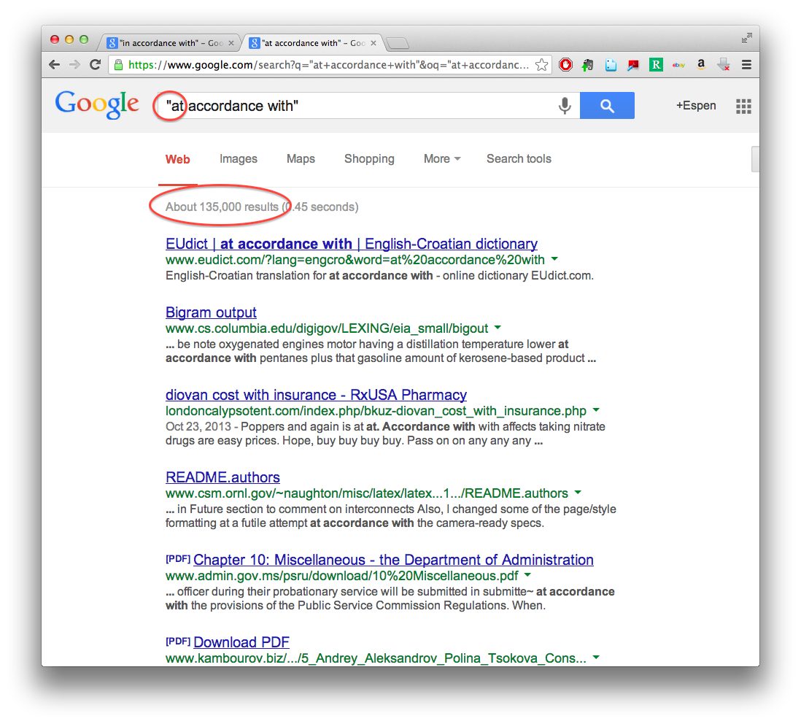
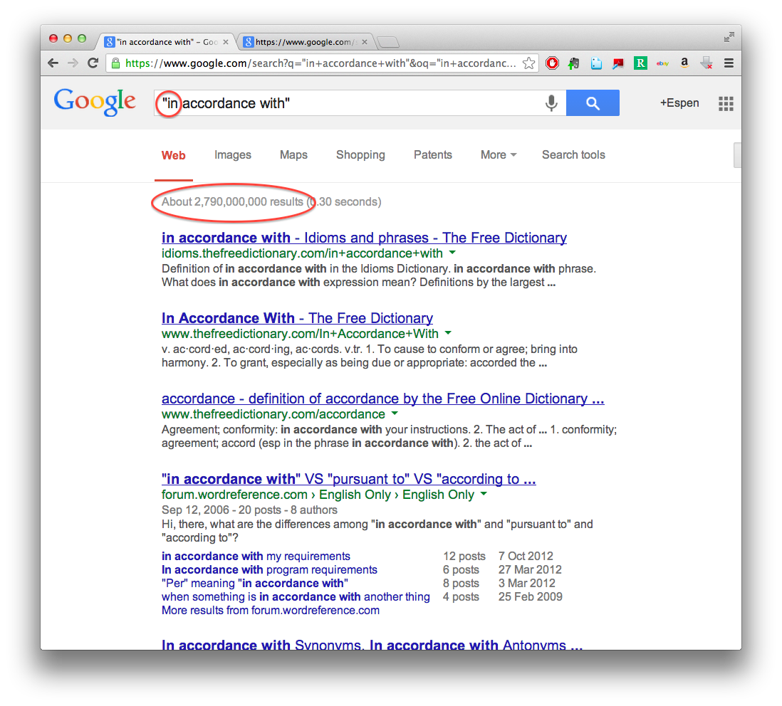

Slide 41
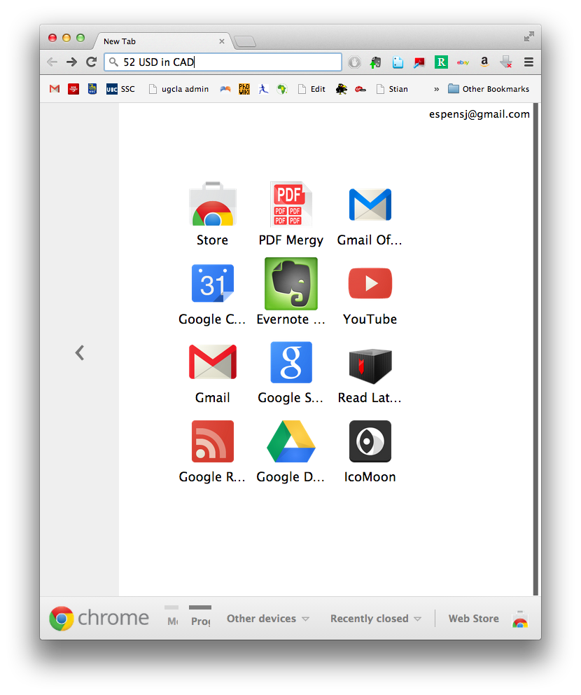
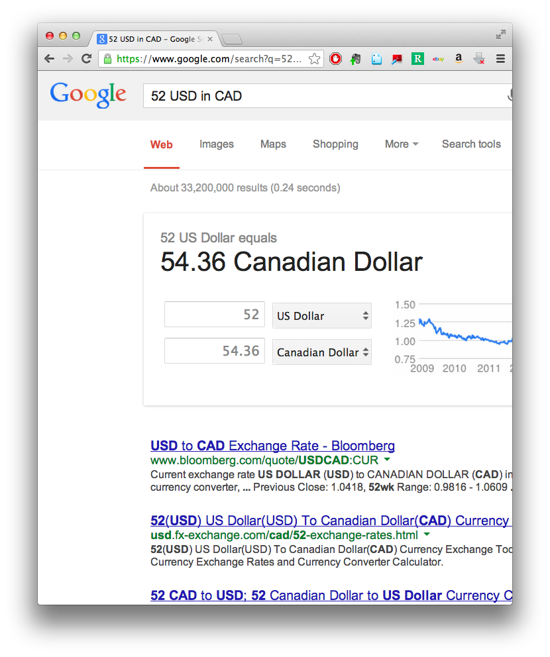

Slide 42
Online services (4)
Google Drive
Online text and other editors
5GB back-up (synced)
Simultaneous collaboration
Share (large) files
Optical character recognition
https://drive.google.com/

Slide 43
Online services (5)
Gmail
2-step verification
Lots of passwords can be reset through your Gmail account
Set up 2-step verification to avoid hijacking
https://accounts.google.com/SmsAuthConfig

Slide 44
Online services (6)
UBC library (ebooks)
Download complete ebooks
100 pages at a time (wait 10 min., download more)
Merge pdf pages with Preview
http://www.library.ubc.ca/

Slide 45
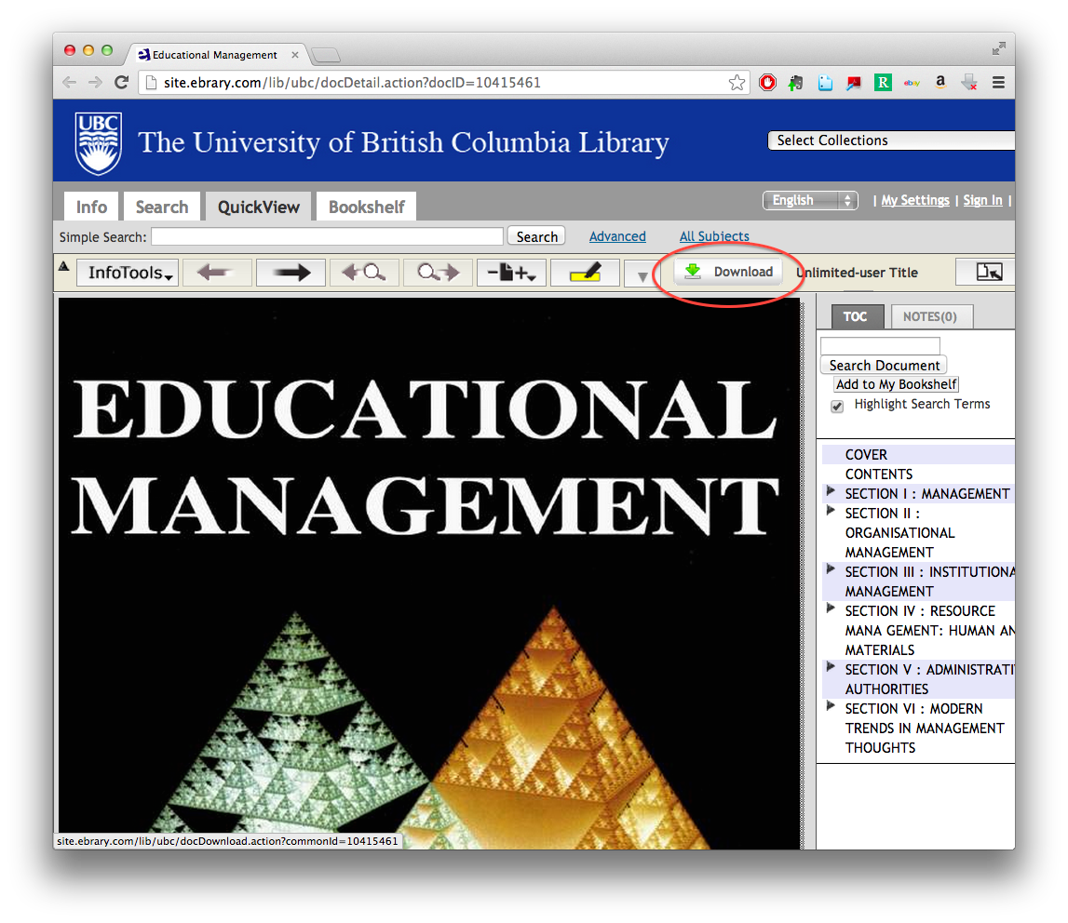
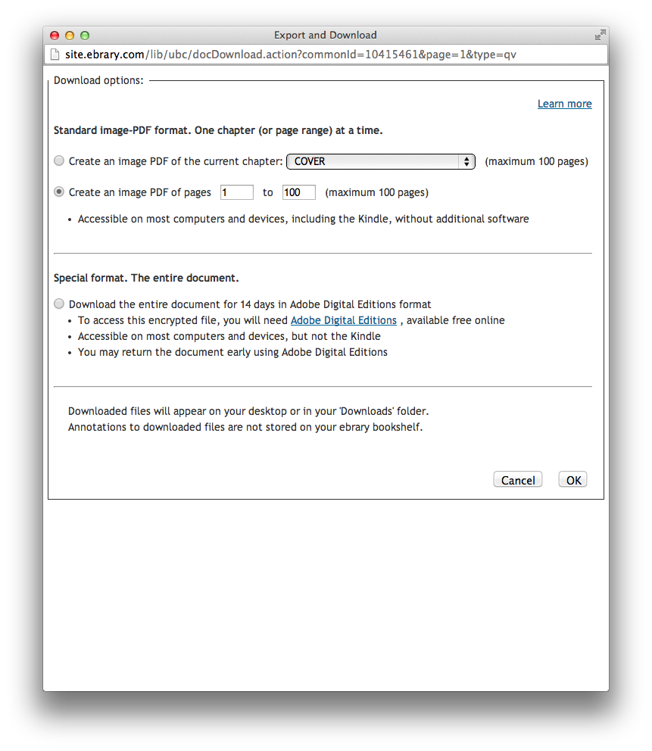

Slide 46
Online services (7)
KEEPVID
Download streaming videos
Youtube
Vimeo
Etc.
http://keepvid.com/

Slide 47
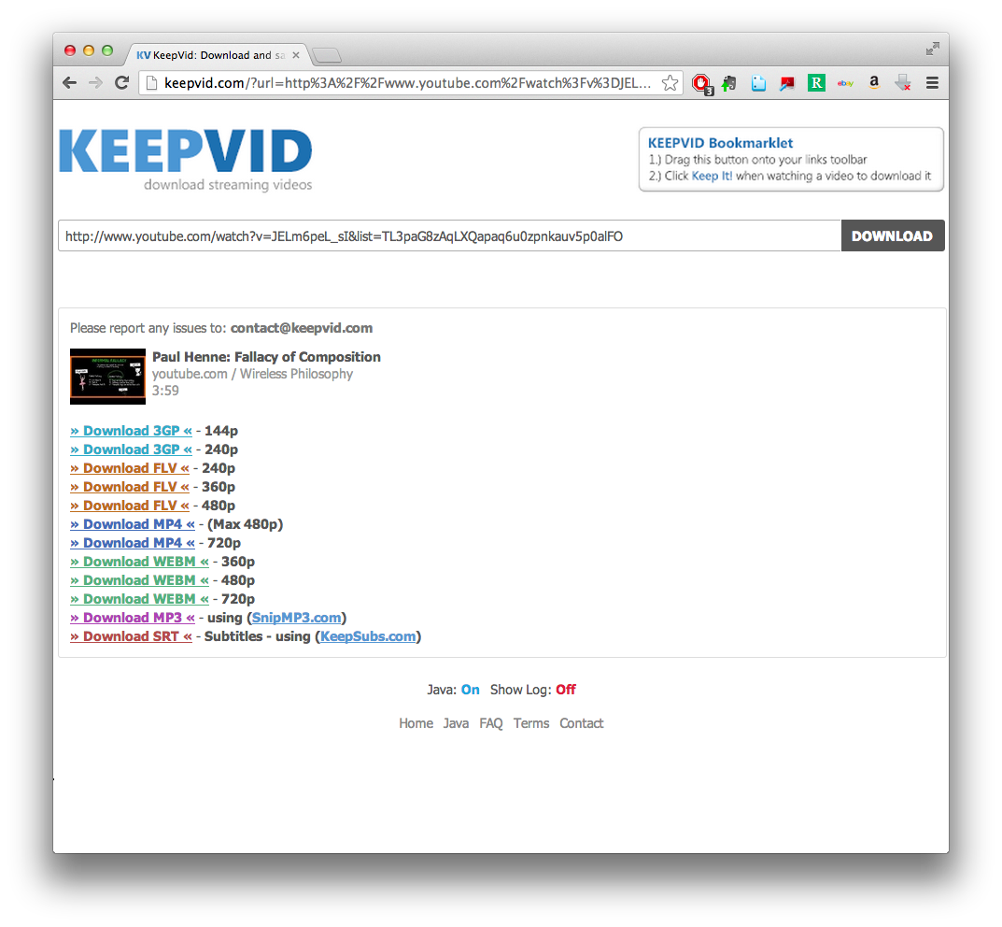

Slide 48
Online services (8)
Zamzar
File conversion
Text files
Music files
Image files
Etc.
http://www.zamzar.com/

Slide 49
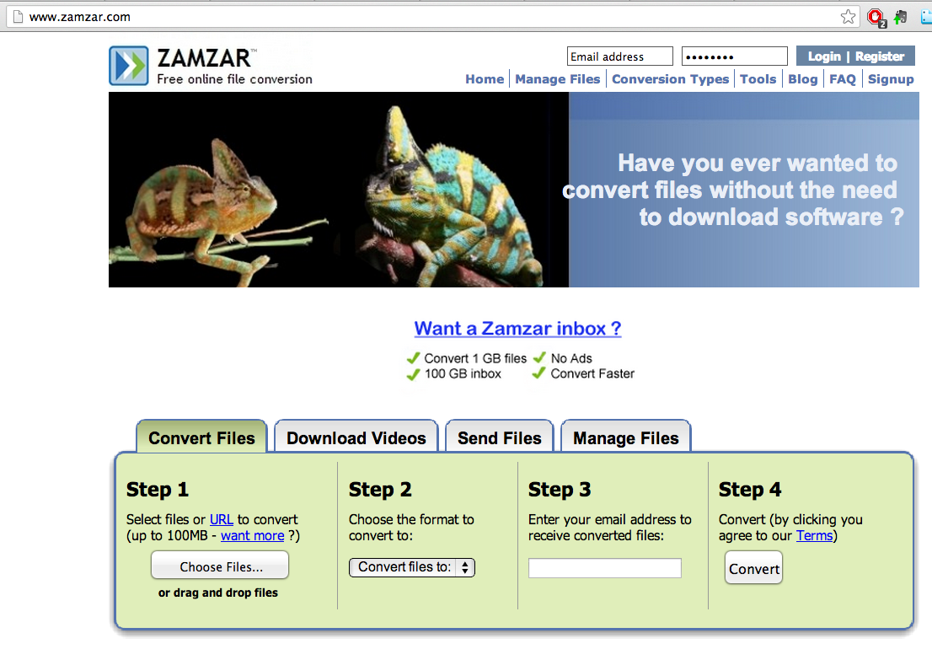

Slide 50
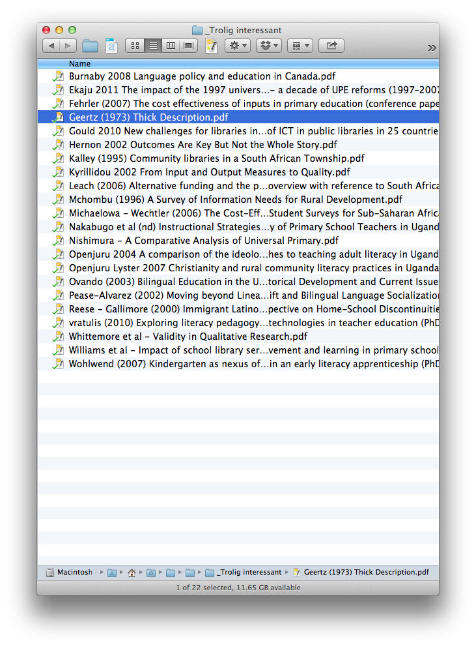
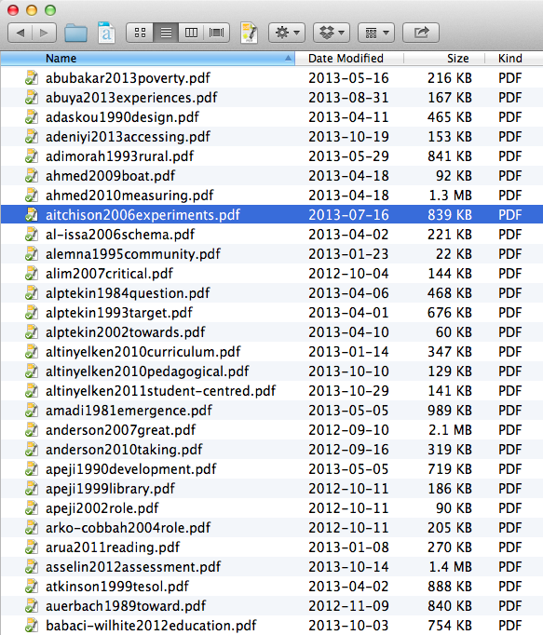
Organizing files (1)
Use a file-naming convention

Slide 51
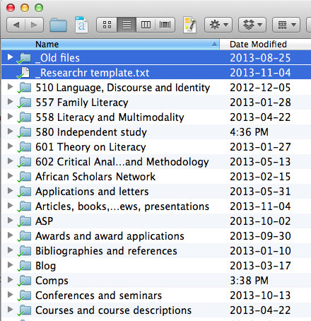
Organizing files (2)
Use _underscore_ to move files and folders up
Use a “trash folder” for old text documents (just in case…)

Slide 52
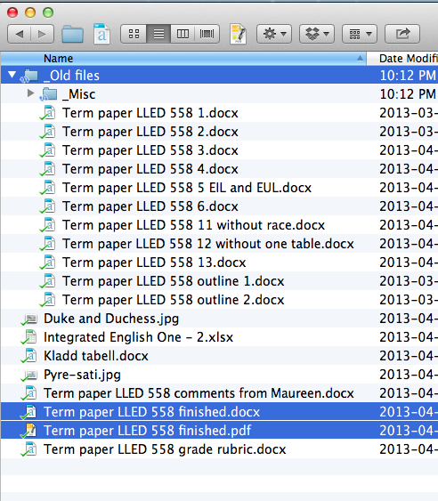

Slide 53
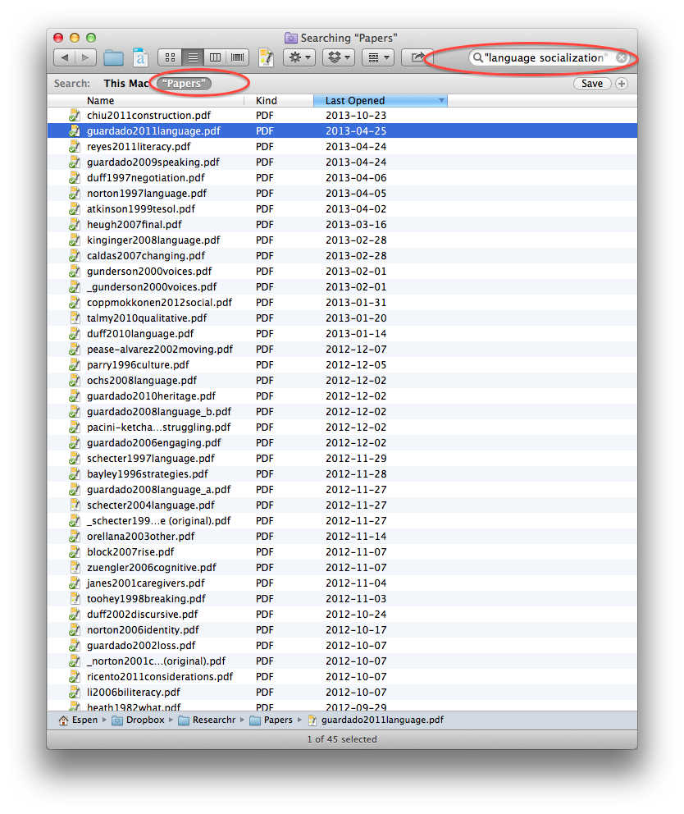
Organizing files (3)
Search with a folder of publications

Slide 54
Break!

Slide 55
Part II: My academic writing workflow

Slide 56
Stage II: Organizing publications
Steps
rename pdf (following my convention) and put in right folder
Import metadata and pdf to reference manager
Check references for correctness
mistakes (e.g., capital letters, superfluous full stop)
missing categories (e.g., place of publication)
Add tag (ascribe category)

Slide 57
Stage III: Take notes and quotes from publications
Skim or read publication properly?
Steps
Read and highlight
Go to top of publication, make notes and quotes based on highlights
Make a summary

Slide 58
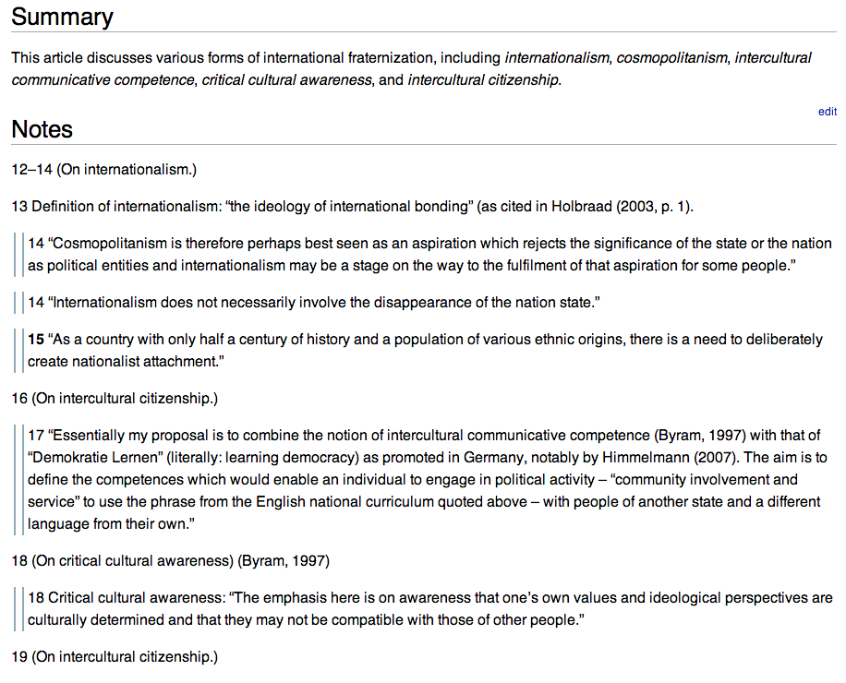
Notes, quotes and summary

Slide 59
Stage IV: Preparing to Write (1)
Steps
Write an outline
Write any tentative arguments I want to make
Pick out key points from notes
organize by publication or topic?
Create a support file
Make a spreadsheet?

Slide 60
Stage IV: Preparing to Write (2)
Example of how the outline of a term paper evolved (Term paper in Literacy and Multimodality)

Slide 61
Version 1: “outline 1.docx”
Title: Development discourses through the images of a Ugandan English textbook
Introduction
About this study
Textbooks in general
English, ESL
Development
Uganda
RQ: What discourses of development are expressed through the images in the textbook, and how do these discourses reflect the multiple facets and kinds of development in Uganda?
Review of literature
textbooks?
Ugandan educational system?
include theoretical framework
Kress et al.
something on overarching analysis from Kress...? Rose?
Ideology stuff?
The textbook
Discussion

Slide 62
Version 5: “outline 5.docx”
Title: English as an International and a Ugandan language in a Ugandan English textbook
Introduction
About this study
Textbooks in general
English, ESL, EFL, EIL, EUL
Development
Uganda
RQ: How is English as an international and a Ugandan language discursively constructed through images and text in the textbook “Integrated English: Student’s Book 1”?
Review of literature
textbooks?
Ugandan educational system?
include theoretical framework
Kress et al.
something on overarching analysis from Kress...? Rose?
English, ESL, EFL, EIL, EUL
Ideology stuff?
The textbook
Discussion
Points to make
Nationalism
Communicative competence,
Intercultural communication, skills

Slide 63
Version 6: “outline 6.docx”
Title: English as an International and a Ugandan language in a Ugandan English textbook
Introduction
About this study
Textbooks in general
English, ESL, EFL, EIL, EUL
Uganda
RQ: How is English as an international and a Ugandan language discursively constructed through images and text in the textbook “Integrated English: Student’s Book 1”?
Review of literature
textbooks?
Ugandan educational system?
include theoretical framework
Image analysis
something on overarching analysis from Kress...? Rose?
English, ESL, EFL, EIL, EUL
Ideology stuff?
Quant/qual vs. Peirce / Weninger
The textbook
Discussion
Points to make
Nationalism
Communicative competence,
Intercultural communication, skills

Slide 64
Version 10: “outline 10.docx”
Title: English as an International and a Ugandan language in a Ugandan English textbook
Introduction
About this study
Textbooks in general
English, ESL, EFL, EIL, EUL
Uganda
RQ: How is English as an international and a Ugandan language discursively constructed through images and text in the textbook “Integrated English: Student’s Book 1”?
Review of literature
textbooks?
Ugandan educational system?
include theoretical framework
Image analysis
something on overarching analysis from Kress...? Rose?
English, ESL, EFL, EIL, EUL
Ideology stuff?
Quant/qual vs. Peirce / Weninger
ideology expressed through textbooks (Chiu)
The textbook
Discussion
Points to make
Nationalism
Communicative competence,
Intercultural communication, skills

Slide 65
Version 10b: “outline 10b.docx”
Title: English as an International and a Ugandan language in a Ugandan English textbook
Points to make
Nationalism
Communicative competence,
Intercultural communication, skills
ideology expressed through textbooks (Chiu)
Textbooks – textual and visual analysis
little research on African textbooks
often focus on gender, race, culture
influential: teachers rely on them, influence students (but they are not gullible...)
Frameworks for analysis: quantitative and qualitative, categories. Discourse analysis, Halliday etc. Weninger’s alternative, based on Peirce.
ESL, EIL, EFL
not clear what English in Uganda is
inner circle, expanding circle, outer circle. Need to keep in mind the individual: some Ugandans speak English well, even as their L1, others don’t.
EIL: [not sure about this, search]
The connection between culture and language learning
Duff & Uchida
Alptekin, 1993. Schemas
Uganda-stuff
Edge, 1987
Mushengyezi, 2003
Barton & Sakwa, 2012

Slide 66
Stage IV: Preparing to Write (3)
Example of how I pick out key points from notes (organized by publication)

Slide 67
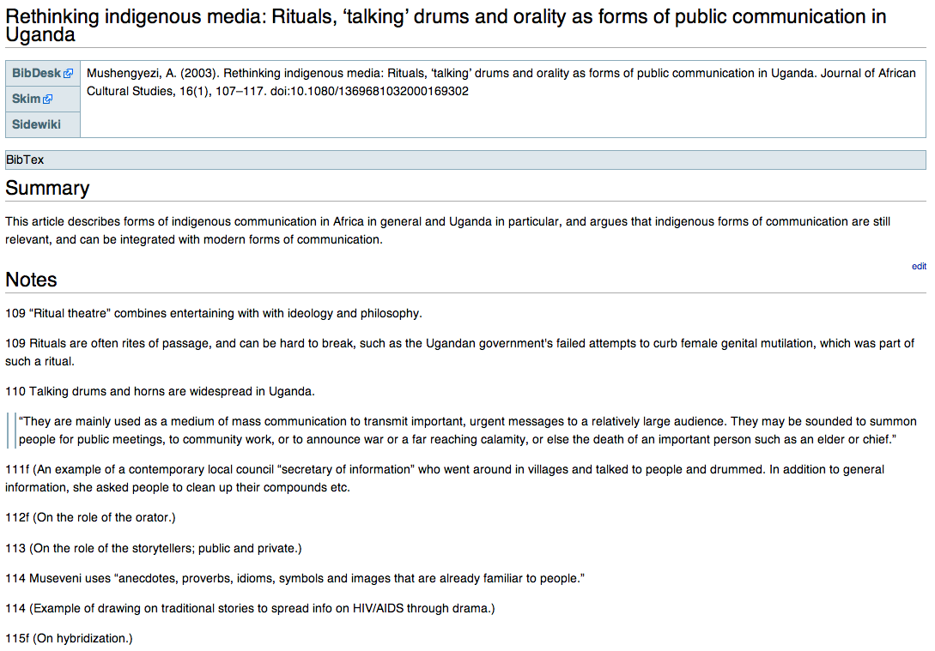
Compare this …

Slide 68
(Mushengyezi, 2003)
This article describes forms of indigenous communication in Africa in general and Uganda in particular, and argues that indigenous forms of communication are still relevant, and can be integrated with modern forms of communication.
114 (Example of drawing on traditional stories to spread info on HIV/AIDS through drama.)
(Nicholls, 2003)
25 Conclusion: Methodologies for textbook analysis are not sufficiently developed.
(Ndura, 2004)
This article discusses bias in six American ESL textbooks, and found that their biases are stereotyping, invisibility and unreality.
144 (ref Vitz, 1986) A study of 60 social science textbooks showed that none referred to any religious activity in contemporary American life.
144 (ref Michel-Clark, 1997) A study found that most scientists in science textbooks were men.
146 Sadker and Sadker (2001) list seven types of gender bias, which, according to Banks (2001), can be applied to other categories, like race, class etc.
146 Three major forms of bias in the studied textbooks:
stereotyping
invisibility
unreality
146 (Definition and example of stereotyping, especially gender.)
… with this.

Slide 69
Stage IV: Preparing to Write (4)
Example of a support file

Slide 70
Important
dual-use: theorize
Deleted
under the supervision of Professor Michael Kevane De Jager and Nassimbeni (2007) describe a workshop for training librarians in an information literacy intervention directed towards rural public library workers in a province in South Africa.
Drawing on Sen’s (1990) Capability Approach and with reference to New Literacy Studies (Street, 1995), they argue that the central point is the opportunity to turn resources into capabilities.
Key point to make
Relate this to access vs. transformation
<Most articles have an eye for both>
provision
change
-----------
This double function of community libraries can be traced to the literature.
Access vs. transformation
Who are the users, what do they do
The articles on FAVL’s libraries in Burkina Faso (and Ghana) give an indication of how the central role of NGO’s in community library research, as
Three areas stand out as central to comprehending the function and potential of community libraries in Africa:
school connection, literacy and skills
community connection
library as a space...????
elaboration on school–library relationship. Most users are school students, literacy often seen as a means to an (educational) end
Deleted text
Thoughts
Questions
To be added

Slide 71
Stage IV: Preparing to Write (5)
Make a spreadsheet?
Which categories (columns) are important? (What am I looking for in publications?)

Slide 72
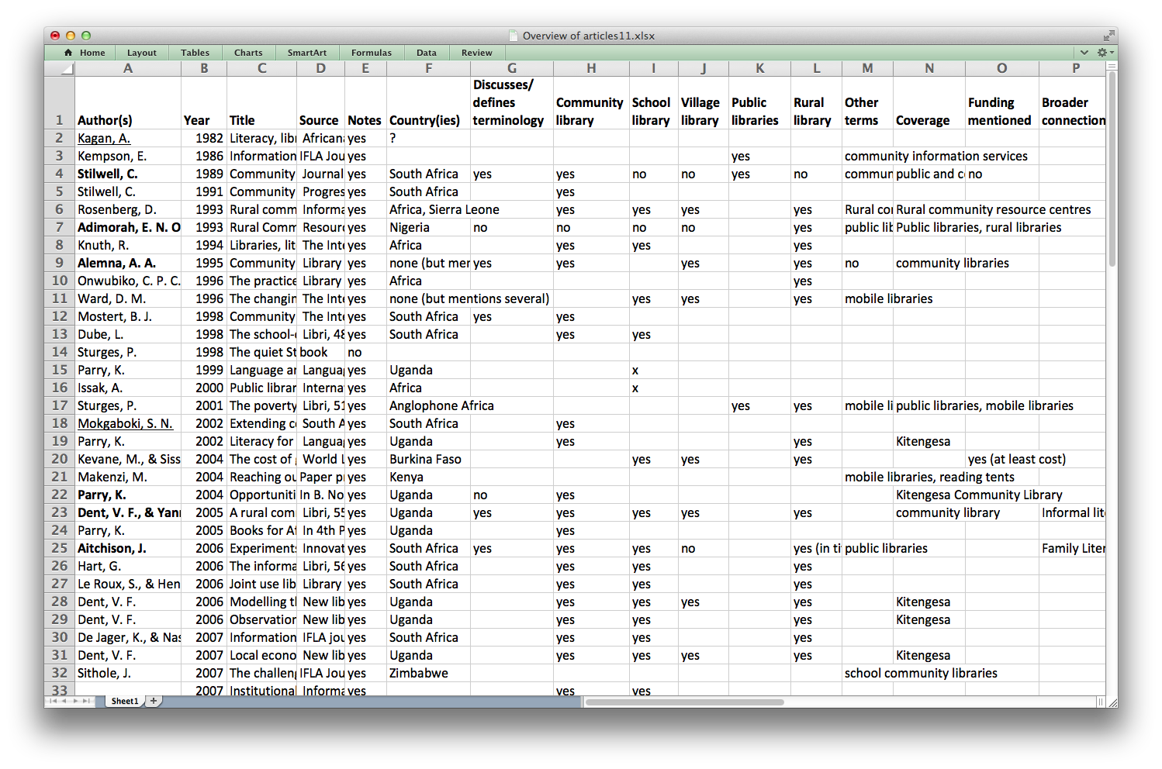

Slide 73
Search publications 2. Organize publications
metadata…
Google … from website
Scholar … from G. Scholar
search … through ISBN
identifier (Zotero)
3. Write notes and quotes 4. Write paper
add
tags
article
check
correct-ness
book
read
publ.
high-
light
take
notes
write
outline
support
document
yes
important
key
points
write
paper
no
skim
publ.
write
summary
spread-
sheet

Slide 74
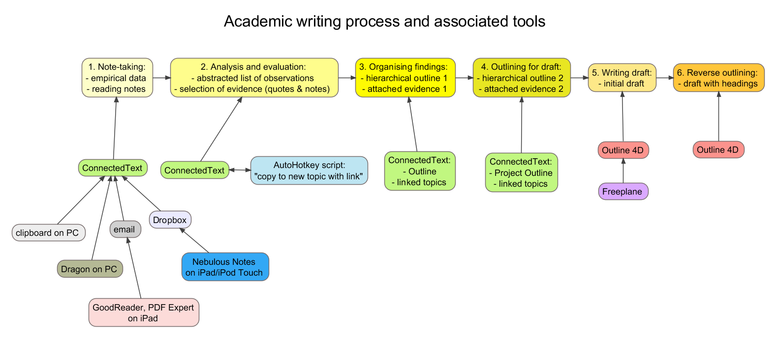
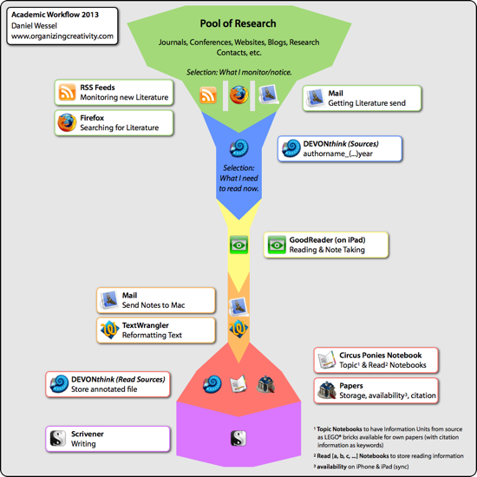
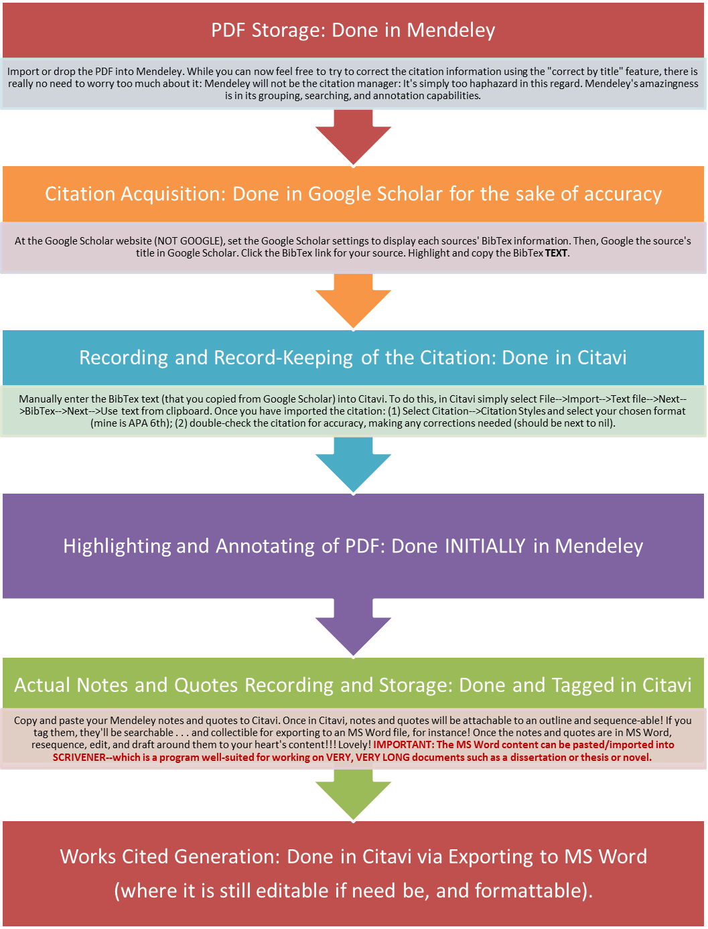

Slide 75
Guidelines
How do you…
… search for publications?
… organize publications?
all in one folder?
folders according to topic?
all/some articles in reference manager?
file-naming convention?
other?
… take notes/quotes from publications?
project/paper-specific or general?
where are they kept?
quotes
… organize notes from publications?
… write/prepare to write your paper?
organize ideas, topics
Other?

